Slide 1
Lecture 3: HTML Deep Dive

Slide 2
HTML DD: Last Week Review
What is HTML
History of HTML
Introduction to Atom Text Editor
Hello World Page
HTML Tags
Semantic HTML

Slide 3
HTML DD: Questions over reading
CH 7
Colors
Transparencies
URLs
Rules
Properties
etc.
CH 9
Selectors
Relationships
Pseudo Elements
Pseudo Classes
etc.

Slide 4
HTML DD: This week overview
Design Your Site
Semantic HTML
Developer Tools
Class Directory
What it is
Setting up
Naming files
URLs, Linking, Images
Image Optimization
Some CSS

Slide 5
Designing Your Site

Slide 6
Designing Your Site
Don’t over think this part we are not looking for award winning designs. I want to see what colors you are going with, see some images placed in, and bring some life to your wireframes
Open Photoshop or Sketch
Set canvas to 1440px wide
Height does not matter when setting up 1024px is a good starting point
I like to set my working content to 1200px
I set guides at 120px and 1,320px
For ease of designing make spacing of elements by units of 5px
Grab Custom Fonts from Google Fonts only
Bulma UI Kit
Other Kits
Bootstrap 3 UI Kit
14 Bootstrap 4 UI Kits
Free UI Kits

Slide 7
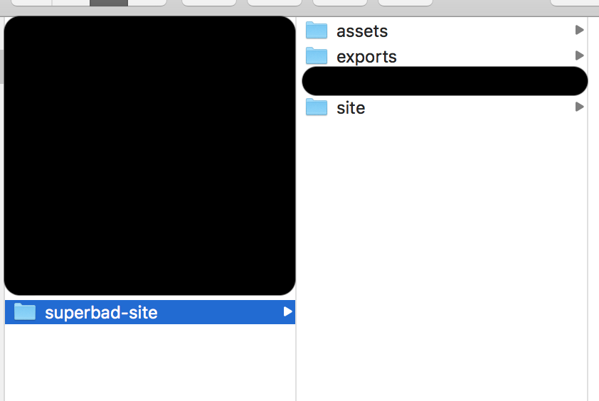
Designing Your Site
Set up a “Branding” canvas
Font sizes
Color Palette
Font Family(ies)
Make sure to pick a Google Font for easier installation
File Structure
Assets - images and any other external files to design your site
Exports - folder to save your files to be loaded into inVision
Site - project files

Slide 8

Designing Your Site
VIDEO LINK

Slide 9

Designing Your Site
VIDEO LINK

Slide 10

Designing Your Site
VIDEO LINK

Slide 11
Let’s talk HTML

Slide 12
HTML DD: Nesting Elements
Parents and Children - an HTML element that contains another HTML element is considered a “Parent Child relationship”
Ex. <article><p>...some text...</p></article> | The <article> is the Parent to the Child <p>
Parents can have theoretically infinite nested children although this isn’t advised. “nested children” <article><p>...some text…<ul><li>...</li></ul></p></article>
Parent Child relationships are extremely important to understand when you begin working with CSS and JavaScript

Slide 13
HTML DD: Why Semantic HTML matters
Accessibility
Users with some type of impairment usually visual
HTML is meant to be universal and all users should be able to view and digest content
YouTube: Introduction to Web Accessibility and W3C Standards
YouTube: Why do semantics matter?
Improved SEO
Search Engine Optimization
Search engines look for particular tags on pages and these will be used as part of your site rating
Beginner Guide to SEO
Google Analytics Demo
Styling and maintenance
If we are coding to the same standard it makes for a better experience picking up new code more efficiently
Makes writing CSS easier and developer understanding

Slide 14
HTML DD: Semantics contd.
HTML was a few years old when CSS1 arrived in 1996. Because of this HTML had to handle some presentation qualities
Lots of text styles for example
Bold
Italic
Sizing
HTML presentation fell out of favor with HTML 4 instead pushed towards CSS styling
HTML5 goes further to make elements less presentational and more semantic
In the end choose tags that describe the content regardless of presentational effects

Slide 15
KITTENS!!!!

Slide 16
Chrome Developer Tools

Slide 17
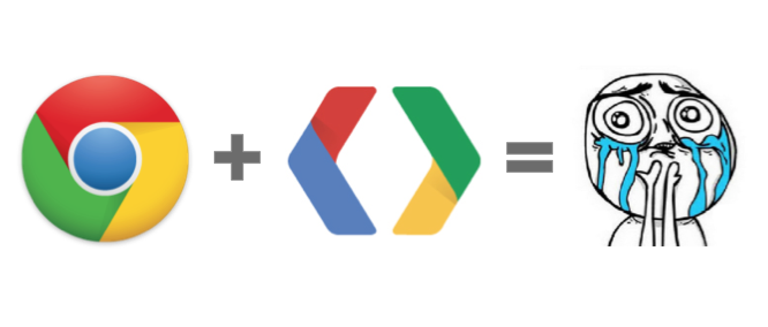
HTML DD: Chrome Developer Tools
The most invaluable source for help is the Chrome Developer Tools.
View and change CSS
Debug JavaScript
Simulate mobile devices
Test responsiveness
Edit DOM elements
Inspect animations
Etc.
Needless to say developer tools is the more crucial way to make sure your site or application is performing as expected

Slide 18
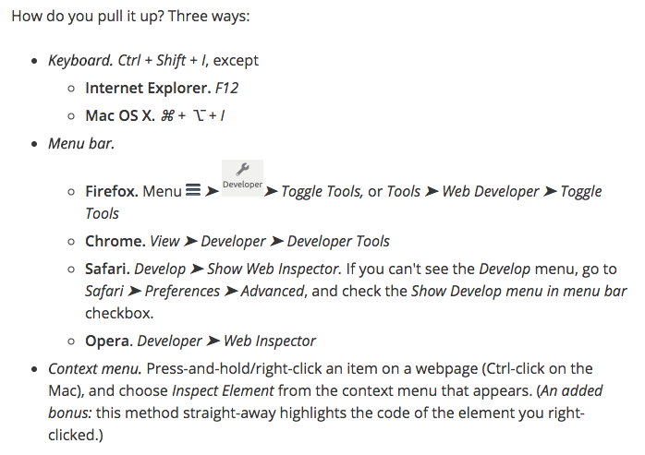
HTML DD: Accessing Chrome Developer Tools
Chrome Developer tools
In creating websites and web applications one of the most important tools is the developer tools.
Every modern web browser includes a powerful suite of developer tools. These tools do a range of things, from inspecting currently-loaded HTML, CSS and JavaScript to showing which assets the page has requested and how long they took to load.
What are developer tools?

Slide 19
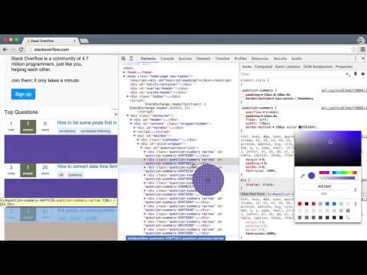
HTML DD: Chrome Dev Tools Tutorial
VIDEO LINK

Slide 20
Let’s try the Chrome Dev Tools

Slide 21
Class Directory

Slide 22
HTML DD: What is the Class Directory?
The Class Directory is meant to serve as a single location for everything we cover in class. It will be the reference you can use to build out your final project.

Slide 23

HTML DD: Setting up Class Directory
Select the storage option
Laptop
USB Drive
Cloud Storage
/class-directory
/assets
/images
.gitkeep
/stylesheets
styles.css
/javascripts
.gitkeep
/fonts
.gitkeep
index.html

Slide 24
HTML DD: File Names
Use Lowercase File Names
media.html, discography.html, photos.html, etc.
Separate words with a dash ‘-’
tour-dates.html, my-profile.html, super-cool-page.html
Dashes are preferred by Search Engines
Underscores ‘_’ are not wrong just not recommended
Be careful of the extensions you use
proper : .html
improper: .htm
What you declare is what will render
.txt will render a text document and so on

Slide 25
HTML DD: Links, Images, and non-text content
Since everything in an HTML document is text anything that isn’t text is merely a reference
The reference is nothing more than text
Browsers are able to interpret all types of files but depending on the browser it may not support particular files
Browsers will do their best in finding a supporting application to assist in supporting unsupported files
You as a developer can also assist in helping browser find applications and extensions to allow the browser to support a non-native file type

Slide 26
HTML DD: URLs
Uniform Resource Locator (URL) is a name for addresses.
Contains information about where the file is
Parts of a URL
https://www.williamsfuller.com/projects/deftones-site/index.html
Scheme
Not Secure: http://
Secure: https://
Others: ftp, sftp, etc.
Server Name
www.williamsfuller.com
Path
/projects/deftones-site/
File Name
index.html

Slide 27
HTML: URLs contd.
There are 2 types of URLs
Absolute - shows the entire path
https://www.williamsfuller.com/projects/deftones-site/index.html
https://www.williamsfuller.com/projects/deftones-site/assets/stylesheets/styles.css
Relative - details where a file is relative to where you are located
./ before writing file path will denote “start from this file and look for the reference”
If we were on the index.html page and wanted to reference the styles.css
./assets/stylesheets/styles.css
When working within files you will typically just use relative paths to grab all your reference images, stylesheets, scripts, etc. from within your project. If you are referencing files outside of your project on the web you’d use absolute paths.

Slide 28
HTML DD: Image Optimization
Last week we didn’t cover Image Optimization
Download a LARGE Google Image
Open https://tinypng.com/
Drag & Drop or Select from filesystem
Compare Images
Do note I have seen issues with this and shadows on .png files with terrible results
Image Optimization in my experience is a great way to cut a ton of weight on your site loading

Slide 29
HTML: Week 3 Homework
Homework
Read: Ch 10 & 11
Designs
Home
About
Discography
Practice Coding
Tables
Import Images
Create lists
Create links
Import and link up Bulma

